Slide 1
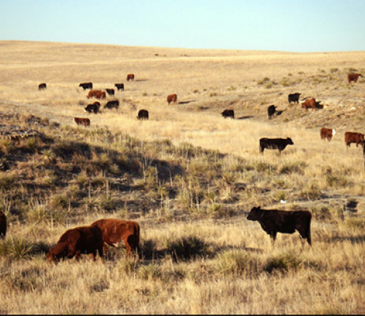
Grazing Management Basics
Notes:
- In livestock production grass is your crop and your management should focus on growing grass and building healthy soil.
- It’s a bottom up system: healthy soils produce good grass, which supports healthy cows. If you take care of the soil you take care of everything else

Slide 2
Overview
How plants grow and why it matters
Forage supply and demand
Carrying capacity and stocking rate
Roots!
Livestock production

Slide 3
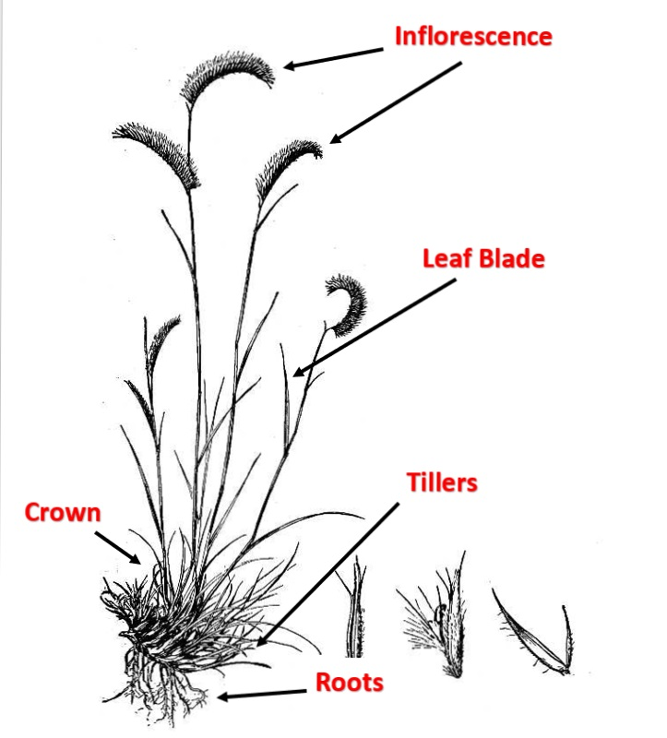
What the parts do!
Inflorescence (Seed head): Reproduction
Leaf Blades: Solar panels! Capture energy
Tillers: Vegetative growth and production
Roots: Store energy and facilitate uptake of water and nutrients
Crown: Stores energy and houses growth points
Notes:
- Seedhead: reproduction, important for longevity and persistence
- Weed seed control. Limiting seed production can effect the overall health of you stand
- Leaves: Solar panels! Turns carbs into growth and energy reserves
- Tillers: Vegetative growth. Growth points that may turn into a seedhead, stems, leaves or roots. Houses buds which have the potential to produce new growth
- Roots: The little battery packs of the plant. They store energy reserves and facilitate uptake of water and nutrients. With a plant is grazed or mowed the plant will draw on it’s root reserves for regrowth and the roots will temporarily die back
- Crown: Persistent base. Stores energy, protects the growth point during winter and plays a critical role in spring regrowth
- If a grass plant is going to live from year to year it must be allowed to manufacture and store sufficient energy to develop buds that will survive over winter and green up in the spring.

Slide 4
Why it matters
Notes:
- Root development is strongly related to the frequency and extent of above ground biomass removal
- first plant is an example of a plant being continually grazed
- Second plant is moderate recovery and the third is full recovery
- Which root system would you rather have in your pasture?
- our 3rd plant has more access to soil moisture, nutrients and more energy reserves

Slide 5
Getting Started
Resource
Considerations
- climate
- Landscape/Topography
- Plant Community
- Management goals
- Wildlife factors
Decisions
- Livestock type
- Number of livestock
- grazing system
- Land improvements
Outcomes/Response
- Plant community
- Livestock production
- Wildlife community
- Management needs
Continual interactions between livestock, wildlife, plants and management decisions
Notes:
- When we’re getting started we have all these factors to think about
- And they’re all connected! Management goals influence all aspects of the livestock decisions, which is in turn influenced by the landscape and plant community.
- There’s no one to one relationship when it comes to land management
- Once management decisions are made there are continual interactions between all these factors
– The plant community is going to the continually influencing your livestock numbers which in turn influences the wildlife, the production and your management needs

Slide 6
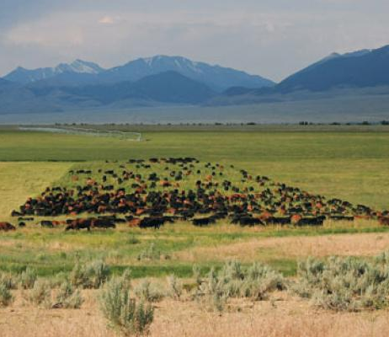
Getting Started
Carrying Capacity: number of animals a parcel of land can support on a long-term basis without bringing down the quality and productivity
Stocking Rate: Number of animals a land manager decides to place on a piece of land for a specified timer period
Notes:
- Lets look at this photo. Is this paddock overstocked? Maybe? Maybe not?
- It depends on the management goals and objectives
- Important to understand the carrying capacity of a site. Which is: Maximum number of animals without inducing permanent or long term damage
- And then decide the right stocking rate for your goals and objectives
- Stocking Rate: number of animals grazing a unit for a specific period of time.
- The expression of animals per acre

Slide 7
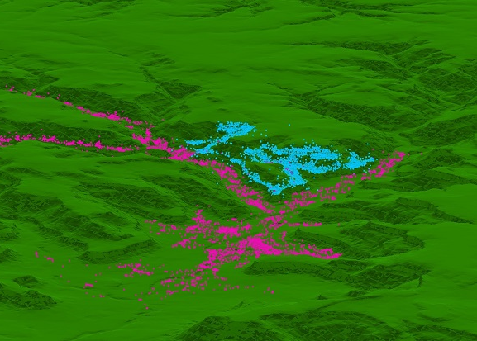
Factors effecting Stocking rate
Topography and plant community – Site potential
Animal species and size
Grazing system (when to graze, when to rest)
Number of animals
Grazing distribution
Notes:
- 1st is assessing the topography and plant community. What is the site potential? How much forage can a pasture reasonably produce and how much of that can be utilized?
- What animal size and type is appropriate for your site and your goals? Are stockers more feasible then a cow/calf operation? Or maybe goats or sheep?
- What sort of grazing system is right for you? They vary in terms of labor and efficiency and require different inputs. Ben will talk more about these
- If you’re starting with a historically over utilized area then the rest period is going to be really important
- Number of animals is dictated by the site potential and grazing system. Is an intensive system right for you?
- Grazing distribution, how your livestock use the pasture. Do they camp out on the bottoms or near water? The map shows GPS points of radio collared cows from a research project in Las Cruces NM. The cows that habitually use the bottom areas don’t venture to the uplands and likewise the cows that prefer the uplands don’t camp out in the creek bottoms.
These patterns effect how the grass is utilized and the overall productivity on the pasture

Slide 8
Balancing Forage Supply and Demand
Animal Unit (AU): 1,00 pounds of grazing animal
Cattle consume 2.5% to 3% of body weight in dry matter of forage per day
Class of Animal | Animal unit Equivalent (AUE)
Cow with calf | 1
Bull, mature | 1.35
Yearling | 0.6 – 0.8
Horse | 1.25
Deer | 0.2
Elk | 0.6
Goat | 0.15
Notes:
Determining the forage demand
What size of animal are you grazing?
How do wildlife use the property?

Slide 9
Balancing Forage Supply and Demand
Animal Unit Month (AUM): Amount of forage an animal will eat in a month
1,000 lb (cow/calf) x 2.5% (body weight) = 25 lbs per day
25 lbs x 30 days = 750 lbs per month
Recommended Use: total forage production x percent utilization = usable forage supply
If 1 acre produces 900 lbs of forage x 30% = 270 lbs of usable forage
Notes:
Why 30%?
We start with the principle of take half leave half. So that takes our recommended use to 50%. Of that 50% only about 20% to 30% actually ends up being consumed by livestock. The rest is utilized in other ways, they get trampled, grazed by wildlife, used as bedding areas

Slide 10
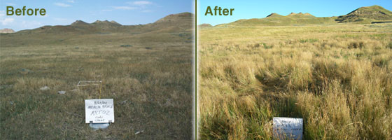
What is proper stocking rate?
It depends!
Plant health, wildlife, erosion, topography, etc.
Set stocking rates to allow for drought and drought recovery
Overstocking vs. overgrazing
Notes:
Overgrazing: grazing exceeds the recovery capacity
Overstocking: Allowing animals to overuse an area. But if the recovery period is sufficient it doesn’t have to lead to overgrazing.
MONITORING!! If you’re unsure if you have the correct stocking rate start monitoring your pastures and see if the condition is trending toward your goal or away from your goal

Slide 11
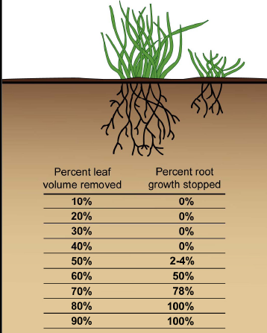
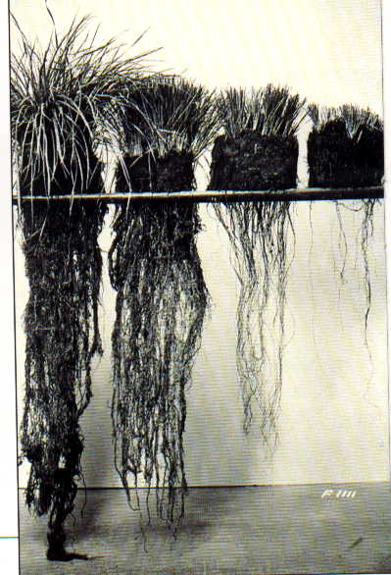
Root Response to Defoliation
50%
70%
90%
Notes:
Why to we manage our grazing carefully?
Plants draw on their roots to regrow after grazing, which affects their access to water
50% removal sweet spot

Slide 12
Stocking rate and Animal Production

Slide 13
Stocking rate of animal production
Notes:
Livestock with a lower stocking rate show fewer disease problems
Have the opportunity to access more palatable species and avoid grazing toxic plants

Slide 14
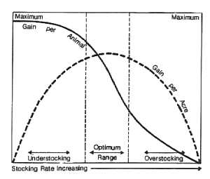
Stocking rate of animal production
Bement 1969

Slide 15
Finding the desired stocking rate
Calculate usable forage
1
Adjust for terrain, available water, forage production, drought
2
Calculate forage demands of livestock
3
Calculate stocking rate
4
MONITOR! Forage varies
5

Slide 16
Summary
Match number and type of animal to rangeland vegetation, topography and climate

Slide 17
Questions??

