Slide 1
Landscape Conservation Cooperatives
The Southern Rockies LCC
John Rice
Science Coordinator
jrice@usbr.gov
December 18, 2013

Slide 2
Key Concepts
Working across jurisdictional boundaries
Landscape-scale
Leveraging the resources of our partners
Self-directed, public-private partnerships
Identifying shared priorities
Scientific decision support
Science development and delivery

Slide 3
How have we managed in the past?
Silos of departments, experts, agencies, managers, researchers, etc.
Many, many jurisdictions
Specific missions, purposes, and methods
Specific data and protocols
Different regulations and goals
Difficult to have one agency represent another
Hard to convince colleagues to work across internal unit boundaries
Language/communication barriers
Cultural differences between organizations

Slide 4
What could we do instead?
“Umbrella” program working across jurisdictional boundaries on a large geographic scale with focus on landscape-scale stressors (climate change) to ensure the sustainability of America's land, water, wildlife and cultural resources
Through collaborative partnerships, provide scientific and technical support, coordination, and communication to resource managers
High-level commitment
Secretarial Order No. 3289, Steering Committee & Working Group leadership from multiple agencies/organizations
Leverage existing efforts of partners (staff, funding, etc.)
Connect efforts and avoid duplication through improved conservation planning

Slide 5
Paradigm Shift
In 2009, Department of Interior established Landscape Conservation Cooperatives (LCCs)
Network of self-directed, public-private partnerships that provide science to ensure the sustainability of America's natural and cultural resources

Slide 6
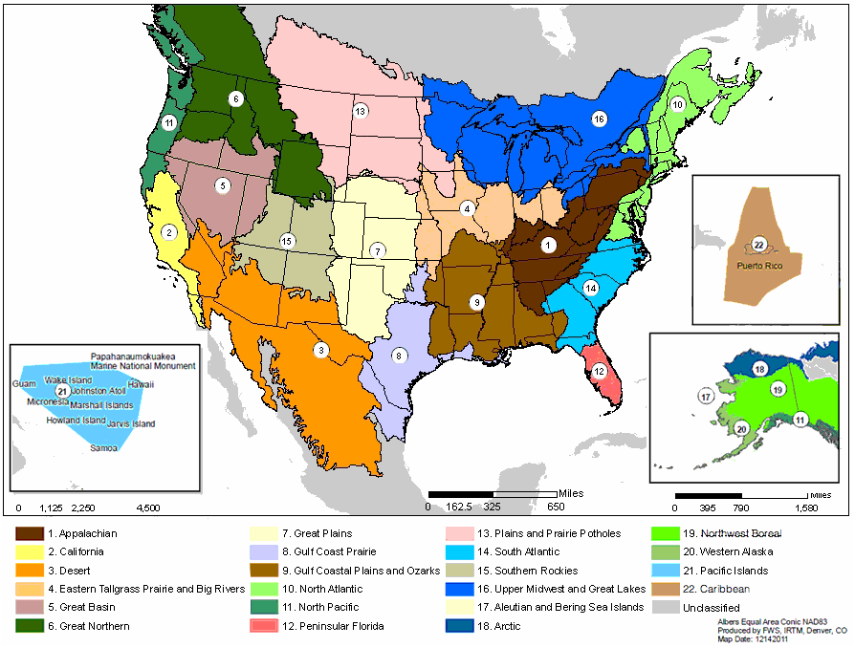
Landscape Conservation Cooperatives

Slide 7
LCC Vision
Collectively build landscapes capable of sustaining natural and cultural resources for current and future generations

Slide 8
What do LCCs do?
Science Development and Delivery
Identify science needs of partners related to priority resources at broad spatial scales
Facilitate the development, integration and application of scientific information (including decision support tools) that will inform resource management decisions
Provide expertise and opportunities to enhance and add value to monitoring programs of various partners through such activities as coordinated data collection, data analysis and information management, and data dissemination, when such actions are mutually agreed to by the partners involved
Collaboration and Communication
Promote and facilitate collaboration and communication among conservation partnerships and entities to support and add value to their efforts to respond to climate change and other stressors and to integrate scientific information into resource management plans and conservation projects
Outreach and Education
Provide information and application tools that educate and apprise resource managers and the public about the effects of climate change and ecosystem stressors

Slide 9
Southern Rockies LCC
Provo

Slide 10
Self-Directed Partnerships
Tribes
Pueblo of Jemez
Shivwits Band of Paiutes
Navajo Nation
Federal
Bureau of Indian Affairs
Bureau of Reclamation
Bureau of Land Management
Fish and Wildlife Service
Forest Service
National Park Service
Natural Resources Conservation Service
U.S. Geological Survey
State
AZ Game & Fish
WY Game & Fish
UT Governor’s Office
NM State Engineer
NM Game & Fish
CO Natural Heritage Program
CO Department of Natural Resources
NGO
Intermountain West Joint Venture
Trust for Public Lands
The Nature Conservancy

Slide 11
Self-directed Partnership Identifying Shared Priorities
Steering Committee sets the Conservation Focus: A landscape that supports and sustains Priority Resources
Cultural Resources
Stream Flows
Native Fish
Sage-grouse
Mule Deer and Elk

Slide 12
Adaptive Management Framework
Work with partners to discuss their priorities and identify any shared resources
Identify Priority Managed Elements for Shared Resources within SRLCC
Identify measurable conservation/management targets for Shared Resources and corresponding Priority Managed Elements
Assess current state of knowledge and identify limiting factors
Compile and apply decision support tools (i.e. climate models, PVA, etc.)
Formulate conservation strategy (including specific management actions) to reach desired objectives and goals
Conservation Delivery (implement conservation strategy and specific management actions)
Monitor effects of management actions on conservation targets
Measure success toward reaching desirable outcomes (objectives)
Measure efficacy of accomplishments towards larger group of conservation priorities)
Revise conservation targets, objectives, or conservation strategy as necessary
Resource
Planning
Monitoring
And Research
Conservation
Design
Conservation
Delivery

Slide 13
Science Development
• Vulnerability assessments
• Climate modeling and development of climate change scenarios
• Decision support tools
• Acquisition and analysis of spatial data
• Resource inventories and monitoring strategies
• Applied research

Slide 14
Funding Announcements
Funding Opportunity Announcement: Non-Federal Applicants for funding through Reclamation’s WaterSmart program
Request for Statements of Interest: Federal Applicants for funding through Reclamation’s WaterSmart program
Request for Proposals: For US Fish and Wildlife Service funding for both Federal and Non-federal organizations

Slide 15
Funding Announcements Eligible Applicants
Separate funding announcements for WaterSmart funding due to the Economy Act which requires that Federal applicants must demonstrate that:
Funding the project through an interagency agreement is in the best interest of the Government; and
The supplies or services cannot be obtained as conveniently or economically by contracting directly with a private source.

Slide 16
Funding Announcements
Eligible Projects
Proposed projects are expected to address the Science Needs and Project Concepts identified and shared by Reclamation and the partners involved in the Southern Rockies LCC
Science Needs and Project Concepts focus science development on priority resources and the current management questions and priorities identified by the Steering Committee
Cost Sharing: Applicants must be willing to cost share 50% or more of the total project costs

Slide 17
Instructions for Proposal Preparation and Delivery
Technical Evaluation Criteria
Application Review Information

Slide 18
FY 2014 Funding Announcements
Anticipated Schedule
Announcement in February-March
Proposal Preparation March-April
Proposal Review April-May
Project Award in June

Slide 19
Science Development Reclamation Funding
To date, the SRLCC has funded 11 Projects totaling over $1 million in federal funding that require at least an equal match in non-federal funding
For FY 2013 – Reclamation received 21 requests totaling about $2,160,000 in federal funding with matching contributions of about $2,836,000

Slide 20
Science Development US Fish and Wildlife Service
To date, the Fish and Wildlife Service has funded 11 Projects totaling about $530,000 for the SRLCC

Slide 21
Thank You !
Example Science Projects
Effects of Bio-control and Restoration on Wildlife in Southwestern Riparian Habitats. Arizona State University
Science-Based Riparian Restoration Planning on the Colorado and Dolores Rivers. The Nature Conservancy
A GIS-Based Evaluation of Fremont Cottonwood Stand Dynamics in the SRLCC. US Geological Survey
Assessment of connectivity and enhancement of adaptive management capacity on Navajo Nation lands. UC Davis
A Regional Model for Building Resilience to Climate Change: Development and Demonstration in Colorado’s Gunnison Basin. The Nature Conservancy
National Wetland Inventory Mapping . Colorado Natural Heritage Program
Vulnerability of Riparian Obligate Species in the Rio Grande to the Interactive Effects of Fire, Hydrological Variation and Climate Change . FS - Rocky Mountain Research Station

