Slide 1

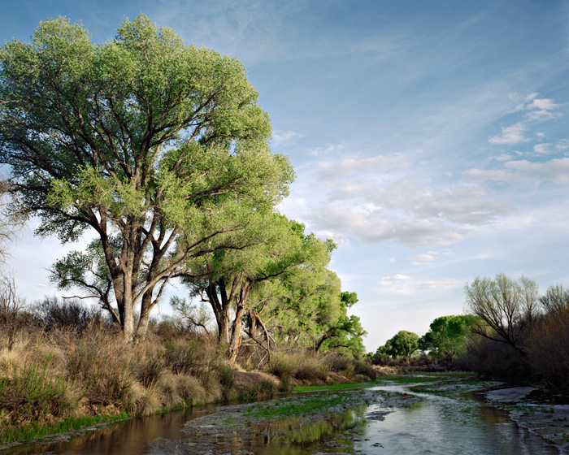
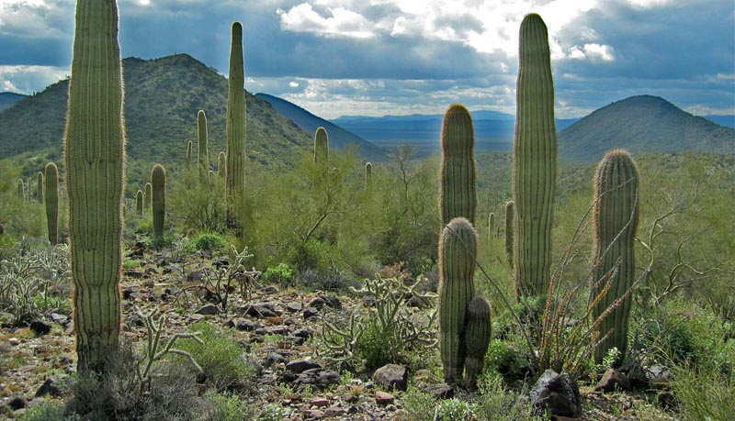
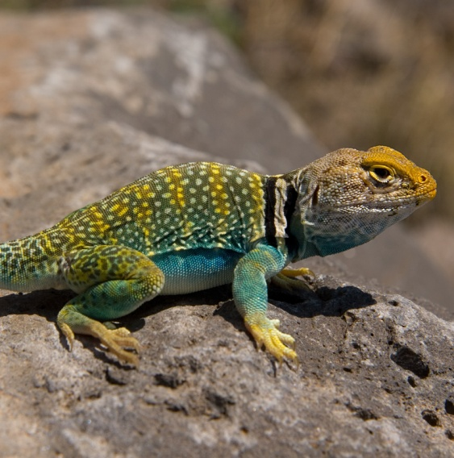
Presentation for
Tamarisk coalition webinar
18 December 2013

Slide 2
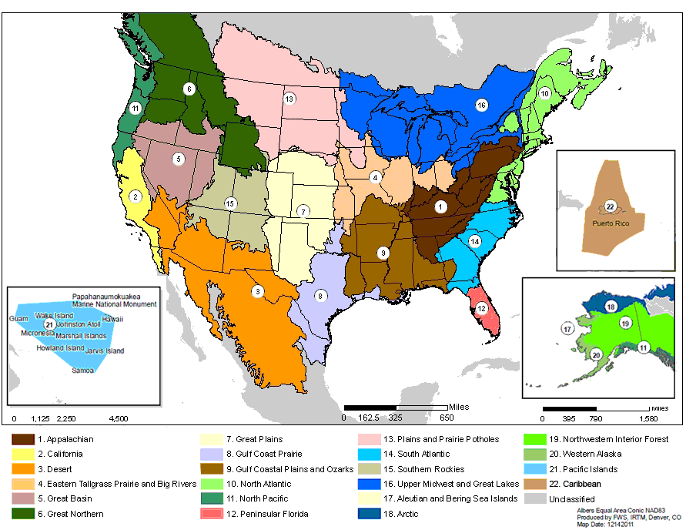
Landscape Conservation Cooperatives (LCCs)
What are LCCs?

Slide 3
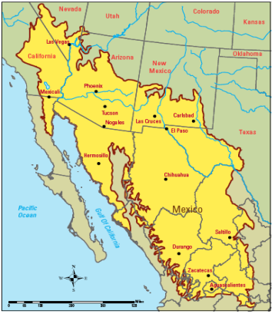
Landscape Conservation Cooperatives (LCCs)
What are LCCs?

Slide 4

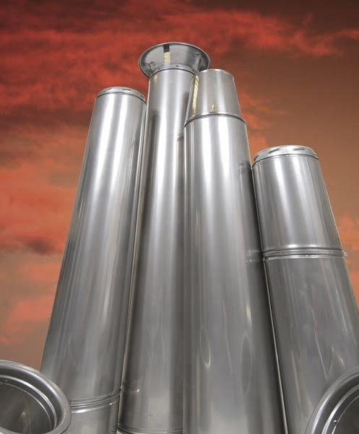
The Science Working Group
6 Critical Management Questions
Purpose: Develop networks, capacity, systems, and processes to deliver science related to landscape scale stressors to natural and cultural resource managers
Forming teams of managers and researchers to be “applied science think tanks” for each CMQ
  Multi-organizational/multi-jurisdictional interdisciplinary problem solving for problems too big for any of us to solve alone
  Opportunity to tap into resources and expertise of multiple partners
Multiple Resources
Multiple stressors
Landscape Scale built on Ecological Boundaries
Applied, Multi-disciplinary Science
Informed, Multi-jurisdictional, Adaptive Management

Slide 5
Overview of Critical Management Questions
CMQ 1: Water management + climate change
CMQ 2: Monitoring species + large scale stressors
CMQ 3: Grassland & shrubland management
CMQ 4: Physiological stress of climate change
CMQ 5: Changing wildfire regimes + riparian habitat management
CMQ 6: Amphibians & reptiles + climate change

Slide 6
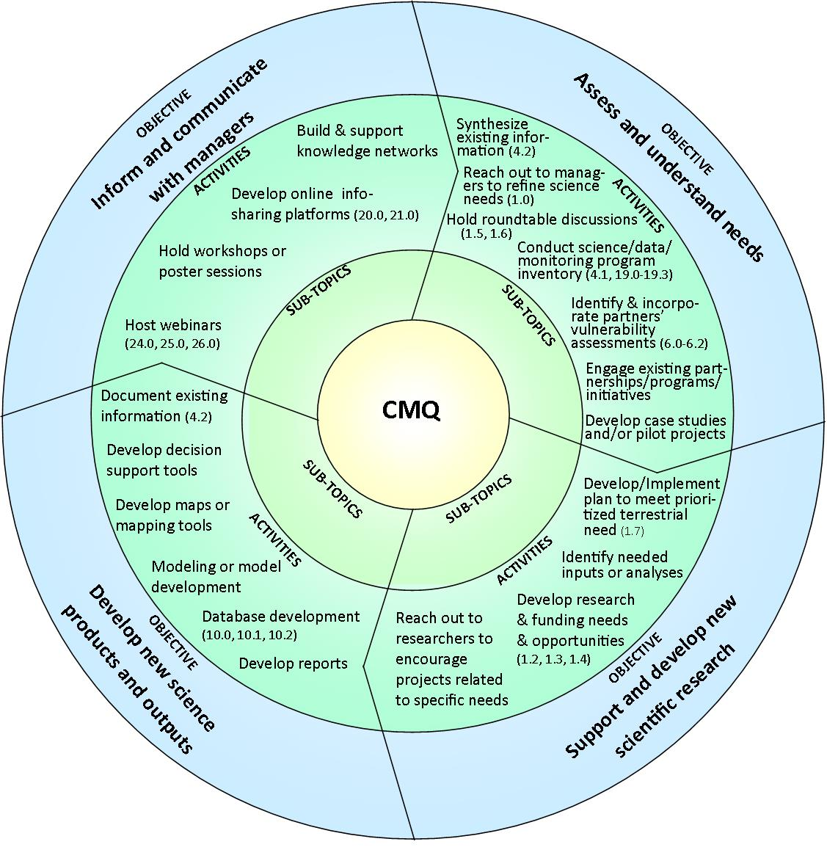
This map depicts the general path each CMQ team will develop.
Activities are listed as examples. Each team will customize the map to include some of these and other activities needed to assess and address the CMQ.
Throughout the process of developing and implementing a work plan based on this map, communication with managers will occur through the SC and the ‘partners list’ being developed for each CMQ.

Slide 7
Resources
Bureau of Reclamation (annual funding for science projects)
    Funding Opportunity Announcement (for non-feds)
    Statement of Interest (for feds)
Fish and Wildlife Service (annual funding for science projects)
    Request for Proposals

Slide 8

Funding
2011: $900,000 for 7 science projects (non-federal partners)
2012: $880,000 for 10 science projects (federal and non-federal partners)
  USFWS and USGS provided approximately $130,000 to support 5 science projects (internal)
2013: $750,000 for 6 projects (federal and non-federal)
  US Fish and Wildlife Service awarded approximately $360,000 for 5 projects (federal and non-federal)
Reclamation: WaterSMART Program (SECURE Water Act and the Fish and Wildlife Coordination Act)
USFWS: Science Applications Program (also includes multi-LCC and national scope funding from Office of the Science Advisor)
Notes:
The projects must be designed for use by resource managers to address natural and cultural resources issues that have a connection to water resources management in a changing climate. Where appropriate, projects also should consider Native American ancestral knowledge and frameworks of understanding on cultural landscapes that allow resource managers to integrate cultural and natural resources into landscape conservation. Projects need not be focused solely on water resources and can focus on other natural resources issues that may affect water resources management (e.g., an endangered species issue that may impact water diversions) or be affected by water resources management (e.g., riparian

Slide 9
Local and State Government Projects
In 2012, the Desert LCC funded over $1.26 million for science that directly benefits existing conservation partnerships, states, local communities, tribes, and international partners.
Supporting Watershed Management Planning for People and the Environment, a project lead by the University of Arizona to develop decision support tools for application to watersheds throughout the LCC. The project will establish a baseline assessment of conditions in the Upper Gila River Watershed that includes potential impacts of climate change and impacts of future watershed management scenarios.
The Gila Watershed Partnership is a community based effort seeking to improve the health of the Upper Gila River Watershed in Arizona and New Mexico.
Members include multiple state agencies, federal agencies, Graham and Greenlee counties, towns of Thatcher, Pima, Duncan, and Clifton, the city of Safford, Freeport MacMoRan Copper and Gold, Inc., and many private citizens.

Slide 10
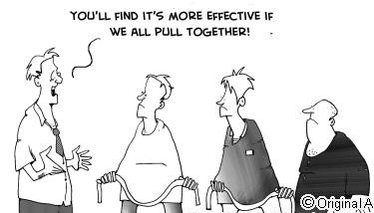
What can you do?
Inform Strategic Planning Efforts
What are your management needs?
What can LCC do to help your program?
What can your program do to help LCC efforts?
Help inform the Science Needs
Participate in future meetings
Participate in working groups or
CMQ teams
Shared information gathering
e.g., participate in webinars

Slide 11
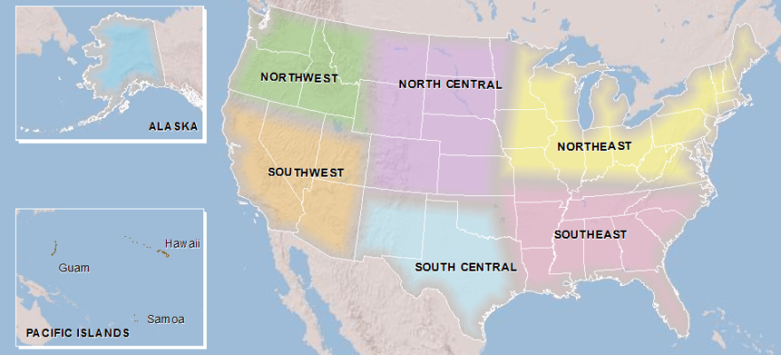
Climate Science Centers (CSCs)
Notes:
DOI recognized that climate change is driving broad changes in global and local ecosystems. As the primary land, water, and wildlife manager in the US (507 million acres of land), DOI has a responsibility to address the impacts of climate change on those resources by developing mitigation and adaptation strategies. In 2009, Secretary Salazar signed a Secretarial Order establishing, among other entities, 8 regional climate science centers. The Centers were designed as partnerships between universities and USGS in order to take advantage of the expertise of both scientists and resource managers when it comes to adaptation science. Our primary stakeholders are agencies within Department of the Interior – including BIA and individual tribes
Arizona-led consortium was competed for and won the SWCSC in October 2010. Formally launched in spring 2011.
Dual leadership
Jonathan Overpeck – University Director
Stephen Jackson – USGS Director; renowned ecologist and botonist with background in paleoclimate research

Slide 12






























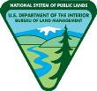


High Level Commitment
Desert LCC
Southwest CSC

Slide 13
Communicating Science & Uncertainty
Vision for the Southwest Climate Science Center:
foster effective collaboration between scientists and resource managers in anticipating, monitoring, and adapting to climate variability and change in the Southwest
identify and apply best practices for translational climate science
Clear communication of scientific capacities and uncertainties

Slide 14
THANK YOU!
Contact Us:
Steve Jackson, Southwest Climate Science Center Director (USGS)
520-670-5591
stjackson@usgs.gov
Jonathan Overpeck, University Director (University of Arizona)
520-626-4364
jto@email.arizona.edu
Alison Meadow, Program Manager (University of Arizona)
520-792-1123
meadow@email.arizona.edu
www.swcsc.arizona.edu
www.doi.gov/csc/southwest/index.cfm

Slide 15
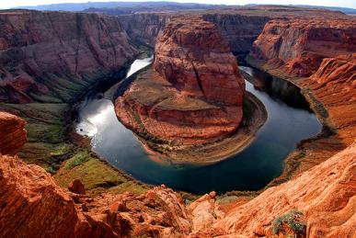

Thank You!
http://www.usbr.gov/dlcc
Sign up for list serve on website
Genevieve Johnson
    gjohnson@usbr.gov
Aimee Roberson
    aimee_roberson@fws.gov

