Slide 1
Great Basin Landscape Conservation Cooperative
Linda Kelly, Coordinator
Great Basin Landscape Conservation Cooperative
December 18th 2013
Presentation for Tamarisk Coalition Webinar

Slide 2
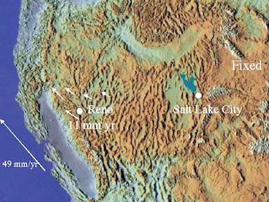
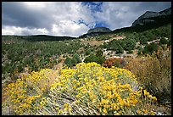
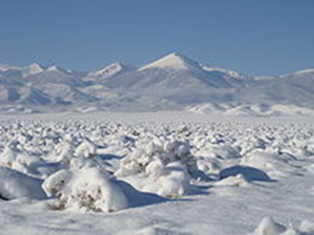
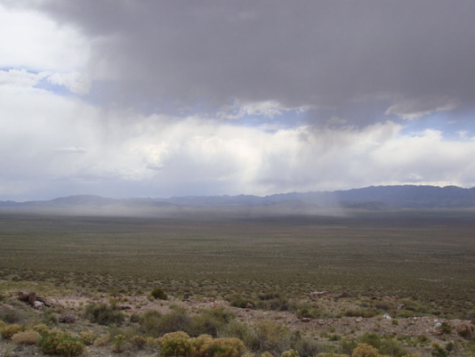
The Great Basin “An Army of Caterpillar's marching towards Mexico” Clarence Dutton 19th century geologist
Recognized by John C. Fremont as an area of interior drainage
145,546 square miles
Precipitation, generally 7-12 inches annually
Notes:
Recognized by John C. Fremont as an area of interior Drainage
145,546 square miles
Annual precipitation, generally 7-12 inches
Major cities, Reno, Boise and Salt Lake City
Located in 5 states: eastern California, eastern Oregon, southern Idaho, Northern and Central Nevada and western Utah

Slide 3
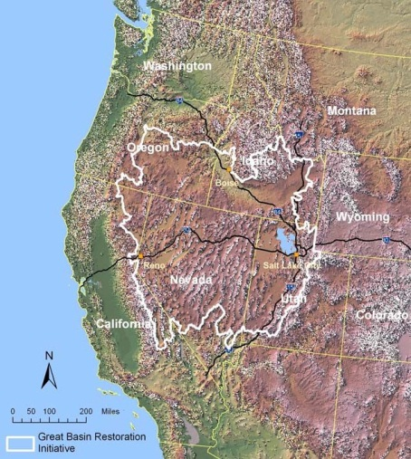
Our Mission
Provide leadership and a framework linking science and management to address shared ecological, climate, and social and economic issues across the basin.
Focus science and management actions to sustain natural resources in the context of changing environmental conditions.
Enhance collaboration to integrate science and management among Great Basin LCC partners particularly as related to climate change and other landscape-scale change agents.
Promote communication and education.
Notes:
Our Mission
Provide leadership and a frame work linking science and management
Focus science and management actions including TEK
Enhance collaboration
Promote communication and education

Slide 4
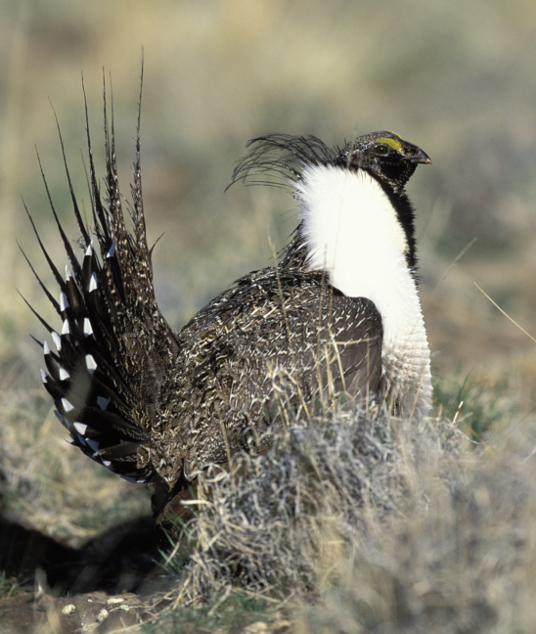
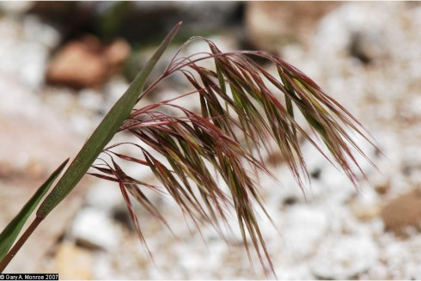
Sage Steppe in the Great Basin
Cheat Grass die-off
Greater Sage-grouse
Bi-State Sage-grouse
Inter-LCC collaboration effort
LC Map for Sage Grouse data
Notes:
The cheat grass die-off was formally initiated in the summer of 2011. The Phase I project was planned as a 3-year study with four principal components: die-off survey work, landscape ecology and remote sensing, exploratory screening of putative die-off causal agents, and experimental field seeding studies with cheatgrass and native restoration species. Data collection has been planned for the first two years, with analysis and manuscript preparation the third year, after currently available funds are expended. Each of these components could be expanded to the level originally proposed, or additional studies as appropriate could be performed, should additional funds be made available at any time.
Greater Sage Grouse habitat is within the Great Basin. LCC coordination efforts include: Inter-LCC collaboration effort between four LCCs: Southern Rockies, Great Basin; Great Northern and Plains and Prairie. LCC staff is working together to identify projects that assist in the long-term management of the species.
Bi-State Sage Grouse; Great Basin LCC facilitating integration of the LC MAP data portal.
Great Basin LCC Science Coordinator Todd Hopkins has been working with interagency leadership on the state and federal levels. Bi-State Sage grouse is a distinct population located near the eastern slope of the Sierra’s in both California and Nevada. Population from south to north extends from the Bishop, CA area to Carson City, NV

Slide 5
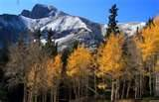
Coordination of Climate information
Great Basin Climate Forum held in 2013: Spring and Fall in Reno, NV and Bishop California
A discussion of current conditions in the Great Basin
In Partnership with:
Desert Research Institute
California Nevada Applications Program
Great Basin LCC
Climate Dashboard
For information: GreatBasinLCC.org
or email: todd_hopkins@usgs.gov
Notes:
Very successful forum designed to include a webinar. Over 65 in person 40 webinar in the spring and 80 in person and 40 on webinar in the fall. We anticipate to hold these forums both spring and fall in the future and move them around the great basin.

Slide 6
Coordination of Climate Information
Forum topics include:
A recap of the summer and early fall climate conditions
Review of summer and early fall wildfire conditions
Hydro-climate effects on rangeland ecosystem soils
Current climate impacts on Great Basin Tribes
Notes:
Forum topics include:
A recap of the summer and early fall climate conditions
Review of summer and early fall wildfire conditions
Hydro-climate effects on rangeland ecosystem soils
Current climate impacts on Great Basin Tribes
We even had the state of Nevada Veterinarian, Peri Wolff, give us a presentation on the effects of current climate conditions on wildlife in the great basin at our first forum
Our aim is to tailor these forums to our communities, and make the relevant and topical for the audience.

Slide 7
Fire and Other Disturbance Effects, Soil Erosion, and Restoration in Sagebrush Steppe
Land use and unintentional (e.g., wildfire) disturbances are increasingly dominant factors affecting land-use planning and management of semiarid landscapes, particularly in sagebrush steppe rangelands.
In the last 10-20 years, wildfires are occurring more frequently and increasingly in very large burn patches.

Slide 8
Fire and Other Disturbance Effects, Soil Erosion, and Restoration in Sagebrush Steppe
Major conservation investments are often directed towards stabilizing soils and promoting native or desirable perennial plant communities that support wildlife and sustain livestock values under current and future conditions.
Dr Germino’s research group is evaluating risks of soil erosion and exotic-plant invasions, and native-plant selection for restoration plantings.

Slide 9
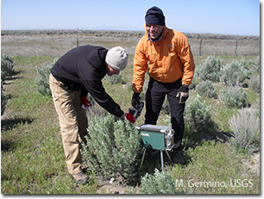
Collaborative Partnering in Science and Land Management
Big sagebrush (Artemesia tridentata) is one of the most widespread and locally dominant species in the western United States, and it has strong effects on its surrounding plant, insect, and animal communities.

Slide 10
Collaborative Partnering in Science and Land Management
Loss of sagebrush habitat due to fire, invasive plants, and other disturbances, along with loss of associated wildlife, has led to substantial trial efforts to restore the habitat via seeding or planting
Restoration success has been mixed, and how selection of seed sources from this genetically diverse species contributes to restoration outcomes is an important question.

Slide 11
Landscape Conservation and Planning
Currently ramping up to conduct our science prioritization process
Review of Rapid Ecological Assessment for the Central Great Basin
Inter-LCC Sage Grouse effort
LC Map for Sage Grouse
Engaged in long-term discussions regarding sage-step dependent species, impact of fire and invasive species

Slide 12
Landscape Conservation Design
Engaged with the NFS EPSCOR program in focusing science toward key risk and vulnerability assessments
Engaged with several researchers funded by the Climate Science Centers and others in the creation of Decision Support Tools
We published studies on blackbrush and climate change, shrub restoration and wind erosion on burned sagebrush-steppe

Slide 13
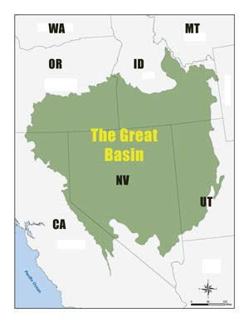
Contact Information
Linda Kelly, Great Basin LCC Coordinator
775-861-6463
Email: ljkelly@blm.gov
Todd Hopkins, Science Coordinator
775-861-6492
Email: todd_hopkins@fws.gov
Matt Germino, Research Ecologist
(208) 426-3353
Email: mgermino@usgs.gov
greatbasinlcc.org
Notes:
There are three staff members on our team: Linda Kelly, Coordinator, and Todd Hopkins Science Coordinator located in Reno NV and Matt Germino, Research Ecologist in Boise ID. Please contact them if you have needs or questions regarding the Great Basin LCC. They are at great basin lcc.org

